Slide 1
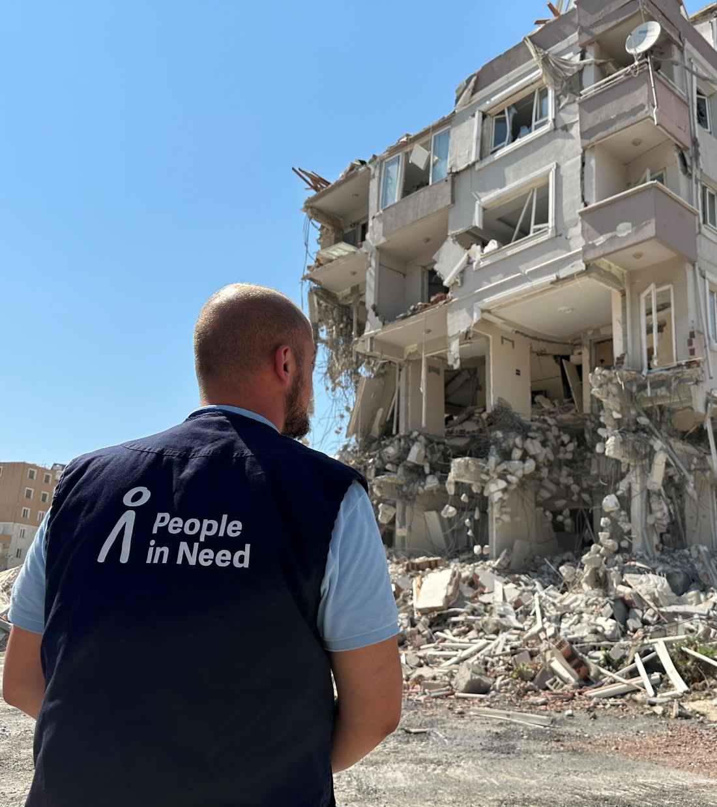

Introduction to
PIN’s Updated English Language and Style Guide

Slide 2
What can you find in this guide?
How we frame our work
We are not heroes/saviours
Power of an image
Problem with “Thank You”
Style
Engaging
Neutral
Broader than a single project
Human-centric
Language
Vocabulary List
Spellings
Acronyms
Figures
Dates
Checklist

Slide 3
Why did we update this guide?
Our aim is to produce engaging content that accurately portrays our work and values, and respects and upholds the dignity of those with whom we work.
It is part of our role as an INGO with a broad audience and a powerful voice to actively challenge such stereotypes and damaging and dehumanising narratives.
This language and communication style guide has been drafted to ensure that our communication reflects our programmatic efforts to be progressive, considered, inclusive and locally-led.
The language and imagery we use should be consistent with our values and consistent across all our outputs. It should be inclusive and not reinforce inequality.

Slide 4
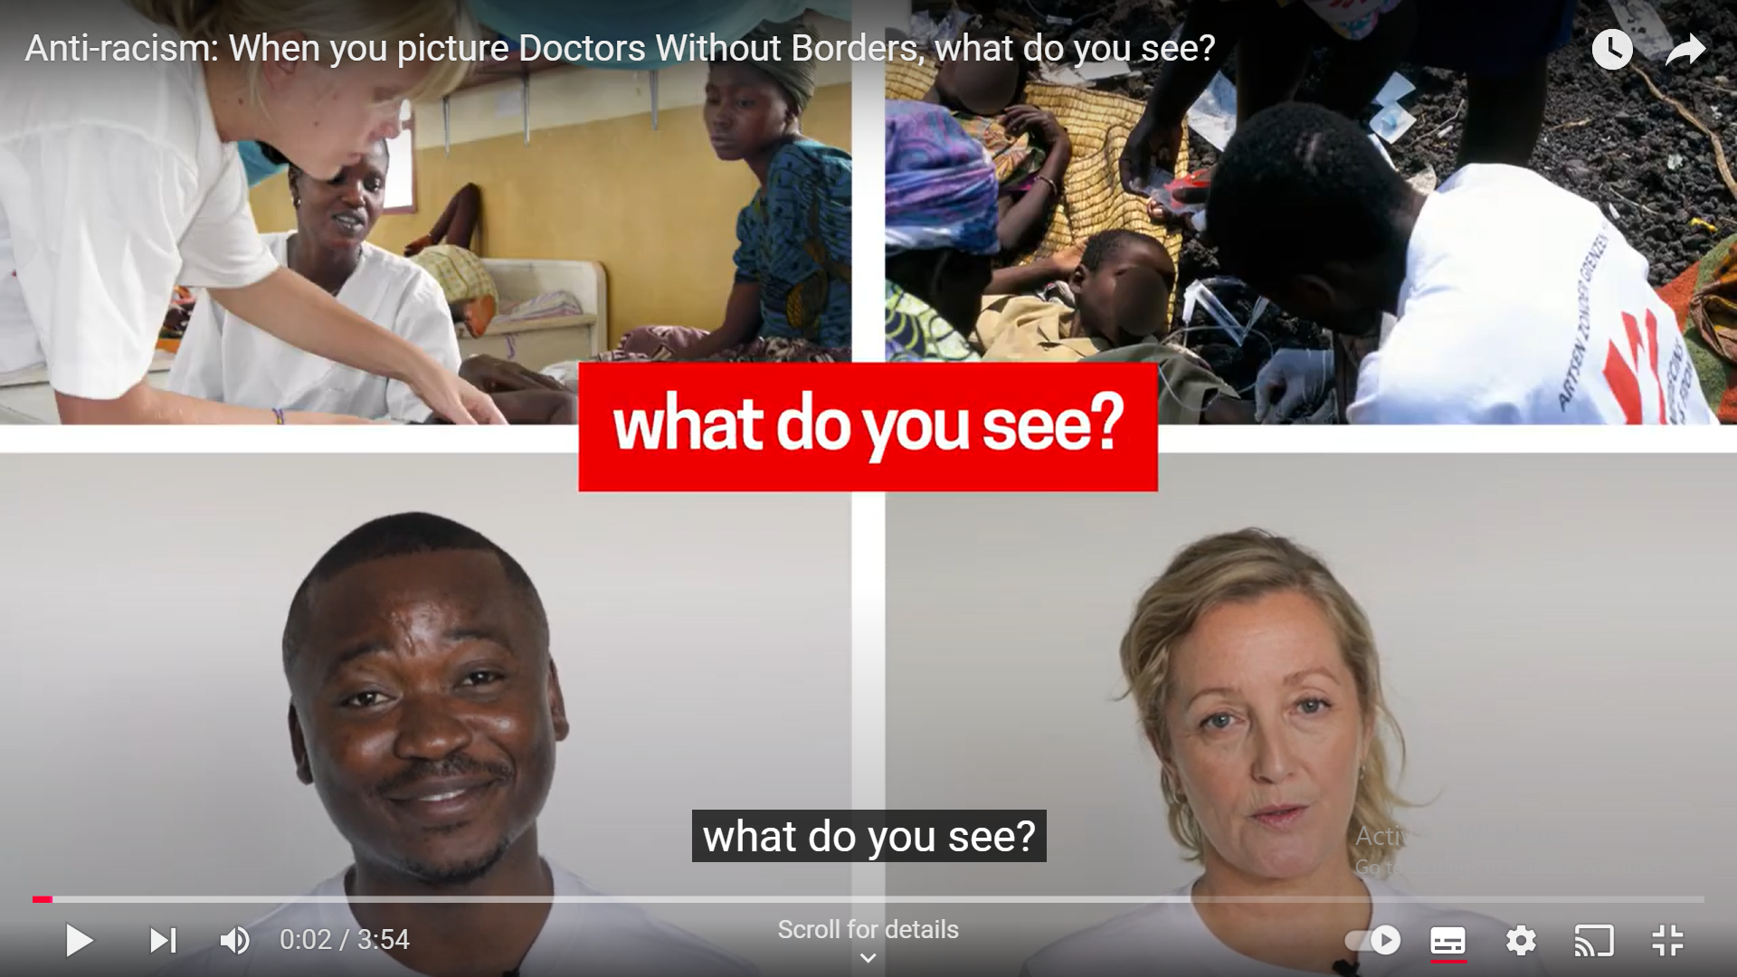
How we frame our work
NGOs are increasingly mindful to avoid language and imagery that perpetuate stereotypes about vulnerable people and communities. But it still happens.
We, at PIN, must ensure that our communications do not:
take away people’s agency/make people out to be passive recipients of aid
reinforce stereotypes (race, sex, age, socio-economic status etc.)
speak on behalf of others
present PIN as a hero/saviour
cause harm

Slide 5
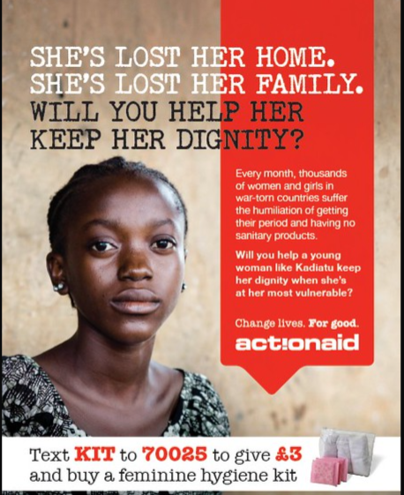

Examples of harmful content

Slide 6

Examples of harmful content
“In this video, children cannot speak for themselves because they are “too poor for words.” This claim is beyond offensive; the video presents the Western donor as the saviour. In addition, the video gives you the impression that just 92 cents a day will save the life of the child you sponsor. When only addressing poverty, structural inequalities, lack of proper health systems and other issues become so simple.”
On this website you can find examples of comms outputs that were shortlisted for prizes for best and worst when it comes to stereotyping through charity campaigns
https://www.radiaid.com/

Slide 7
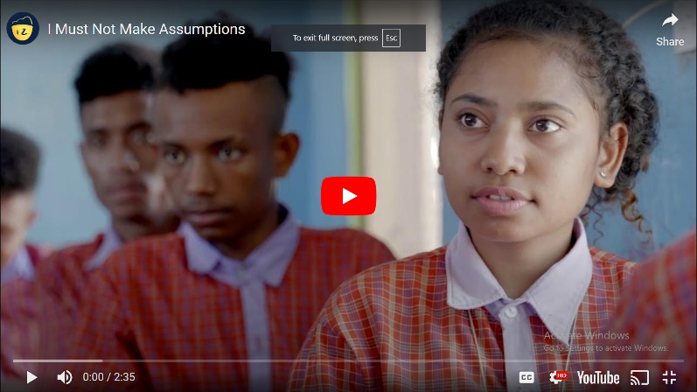
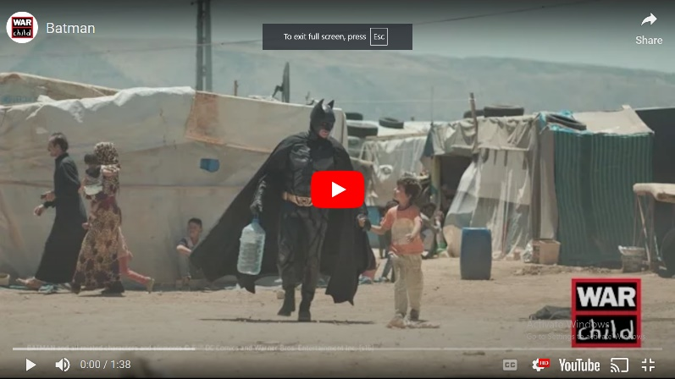
Examples of great content
That actively challenge stereotypes and damaging and dehumanising narratives.

Slide 8
We are not “heroes”
We must not present PIN as a ‘saviour’, ‘solution’, ‘hero’, ‘changing lives’ or ‘giving hope’ in the contexts we work.
We must not present the people we support as ‘victims’ or passive recipients of aid.
We work with local communities and with local partners and this should be reflected in the language and imagery we use in our communication.
We must show the agency of the people we support and the local partners and communities we work with.
Example of providing training and grant which “changed someone’s life.”

Slide 9
Re-framing our content – social media
We helped X poor people/We transformed the lives of poor people in...
We help vulnerable girls.
Our cash assistance transformed X’s life…
We work with local communities to break the cycle of poverty…
We work with girls facing social exclusion because of X to help them do Y…
With cash assistance, X was able to recover faster from Y and do Z…

Slide 10
The Problem with “Thank You”
When conducting interviews, people who we have supported may thank us, the organisation and the donors, or may say things to the effect of “without PIN, none of this would have been possible” etc.
However, we should try to avoid including this in our final communication output without greater context or additional quotations, and steer away from this being the headline, main quotation or focus.
There are a few reasons for this. The main ones are:
It can sound forced. It is easy for it to look like they felt obliged to say “thank you”, or worse, that we asked them to say this.
The interviewee may assume that this is what we want to hear, and given the inherent power-dynamics may believe that by saying what they think we want to hear that will somehow impact their allocation of assistance, future assistance etc.
Without greater context it reinforces this “aid recipient” narrative

Slide 11
Style
Engaging:
Avoid project or technical language such as: project cycle, implementation, donor, funding etc.
Focus on comprehension – if you showed a relative or friend your content, would they understand it, would they be engaged?
Neutral language:
Specific vocabulary issued by UN OCHA for the country/context should be our guidance in this regard.
If there is specific language that we should use in your country, you can provide this as an annex to the document.

Slide 12
Style
Broader than a single project:
Does the article/story/video describe only the achievements of a single project and therefore appear to be a piece made specifically to satisfy a donor-visibility requirement? This should be avoided.
We can make interesting, insightful comments on the bigger themes, such as climate change / unemployment / humanitarian access / the role of civil society etc. through what we have learned during the project, and use the RDD Communication Messages to show what we are doing in this sector longer-term as well as globally, and why we work on this issue.
This will engage a broader number of readers, make the piece seem less like a donor-visibility requirement and give us an opportunity to communicate an insightful message to our audiences.

Slide 13
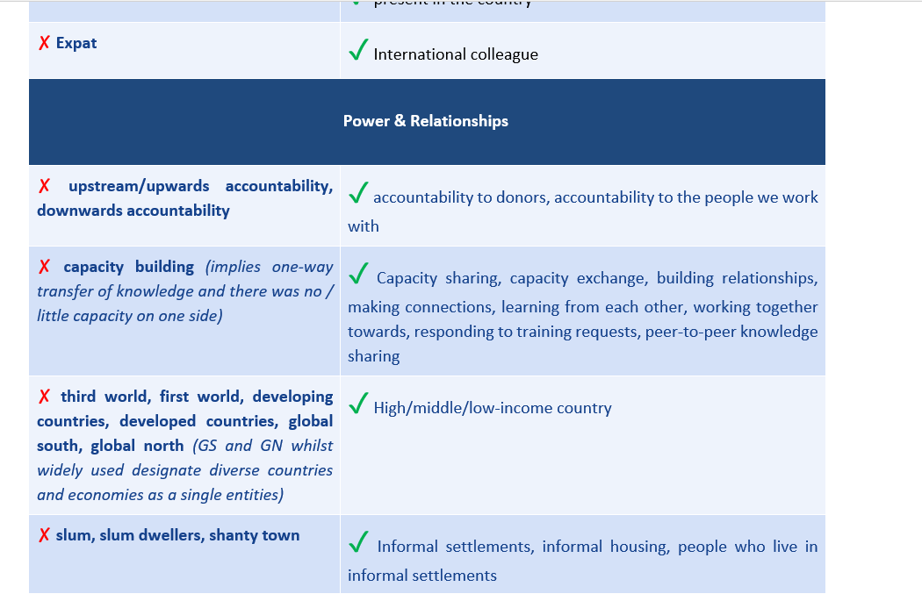
Language
What is acceptable and preferred in terms of specific language use in our sector has also changed a lot in recent years, with organisations realising the inherent bias, negative implications and connotations of certain common humanitarian and development vocabulary.
The guide includes a vocabulary list
of terms we should and should use

Slide 14
Spelling
UK/British English spellings
At PIN, when writing in English, we follow British English spelling guidance, rather than American English.
The document includes a glossary of commonly used words in UK vs. US English.
US | BRITISH
center | centre
theater | theatre
meter | metre
liter | litre
US | BRITISH
color | colour
behavior | behaviour
labor | labour
neighbor | neighbour
US | BRITISH
organize | organise
recognize | recognise

Slide 15
Acronyms, Figures & Dates
Acronyms
For clarity for the audience, it is good practice to always write the full words with the corresponding acronym in brackets in the first reference in order to introduce the acronym. The periodisation of acronyms and initials should be avoided:
Figures
Figures
Figures should be broken up with commas:
✓ 1,000,000 ✗1000000 ✗ 1.000.000
Avoid using the abbreviations EUR, USD, and GBP unless needed for clarity*:
✓ £100 ✗ £100GBP ✗ GBP£100
Dates
The European date model should be used:
✓ day-month-year
✗ month-date-year
✓ PIN | ✗ P.I.N.
✓ US/USA | ✗ U.S./U.S.A.
✓ EU | ✗ E.U.

Slide 16
Get in Touch
If you have any questions going forward or suggestions for what other messages should be included in the document please get in touch with us!
    Dermot Nolan, Anna Prihoda Munter, Conor Plese
    Petr Stefan, Tereza Hronová, Lucie Miklová or Ivan Dzido

Slide 17
Thank you!

